Slide 1
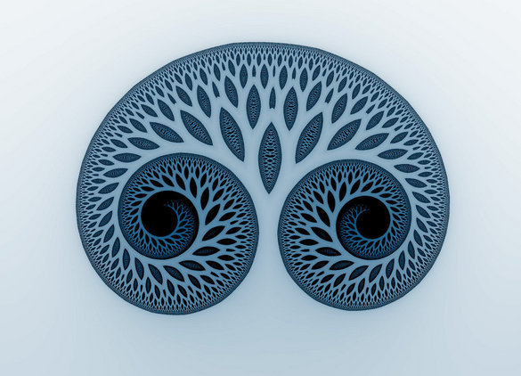

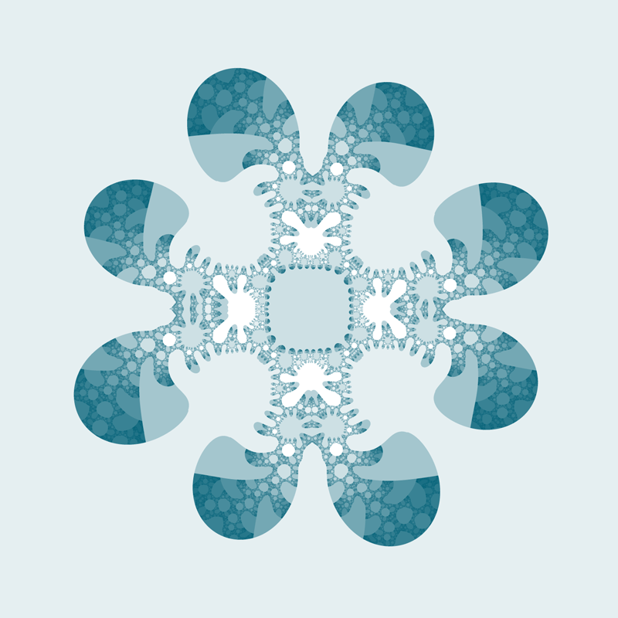
Use of Fractal Geometry in Two / Three Dimensional Image Compression.
Presented by: Nabin Mulepati Advisor: Dr. Brakke

Slide 2
Introduction
Mathematical Background
2D Fractal Image Compression
3D Fractal Image Compression

Slide 3
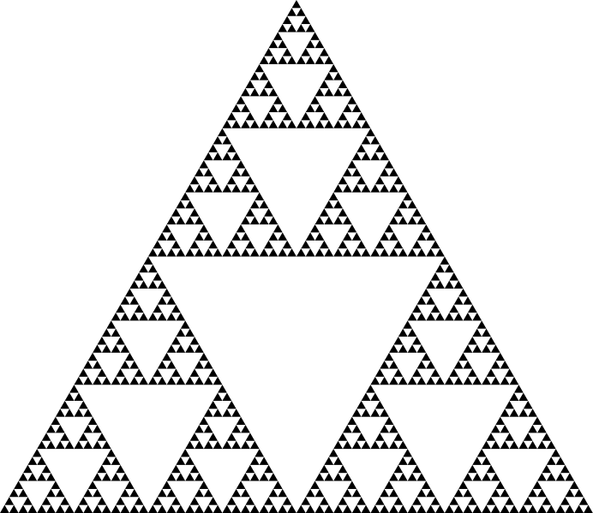
What is a Fractal?
A Fractal is a geometric shape that is the union of parts, each of which is a reduced-size copy of itself.
Infinitely complex
patterns.
The Sierpinski Triangle
Notes:
Word first coined by Beniot Mandlebrot in 1975. He is known as the father of Fractal Geometry.
Infinitely complex pattern because you can zoom in and find the same shapes forever.

Slide 4
What is a Fractal?
A Fractal is a geometric shape that is the union of parts, each of which is a reduced-size copy of itself.
Infinitely complex
patterns.
The Sierpinski Triangle
Notes:
Word first coined by Beniot Mandlebrot in 1975. He is known as the father of Fractal Geometry.
Infinitely complex pattern because you can zoom in and find the same shapes forever.

Slide 5
What is a Fractal?
A Fractal is a geometric shape that is the union of parts, each of which is a reduced-size copy of itself.
Infinitely complex
patterns.
The Sierpinski Triangle
Notes:
Word first coined by Beniot Mandlebrot in 1975. He is known as the father of Fractal Geometry.
Infinitely complex pattern because you can zoom in and find the same shapes forever.

Slide 6
What is a Fractal?
A Fractal is a geometric shape that is the union of parts, each of which is a reduced-size copy of itself.
Infinitely complex
patterns.
The Sierpinski Triangle
Notes:
Word first coined by Beniot Mandlebrot in 1975. He is known as the father of Fractal Geometry.
Infinitely complex pattern because you can zoom in and find the same shapes forever.

Slide 7
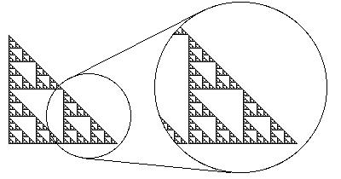
Self-similarity
A self-similar shape is exactly or
approximately similar to a part of itself.
An important
property
of fractals.

Slide 8
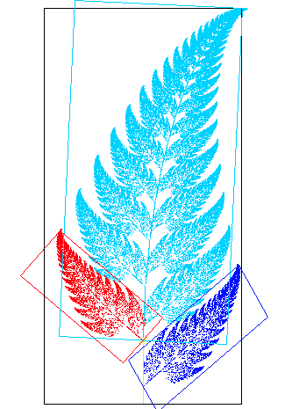
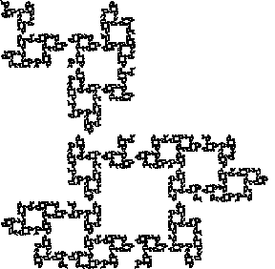
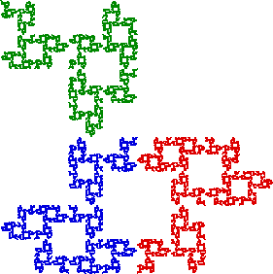
some more examples
Cantor set fractal
Fern

Slide 9
So how do we construct Fractals?
Although fractals are very complex,
they are simple to generate.
There are many different
techniques.

Slide 10
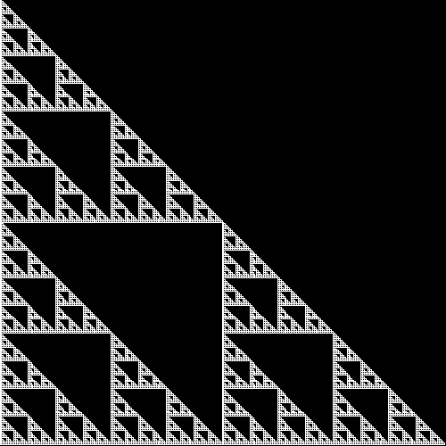
Iterated Function Systems (IFS)
The Sierpinski Triangle

Slide 11

Construction of Sierpinski Triangle using IFS
Take a triangle and connect the midpoints of the three sides to from another triangle at the center.
Then remove that triangle and repeat the process in there new triangles formed.
Think of it in terms of transformations.

Slide 12
Construction of Sierpinski Triangle using IFS
Take a triangle and connect the midpoints of the three sides to from another triangle at the center.
Then remove that triangle and repeat the process in there new triangles formed.
Think of it in terms of transformations.
a

Slide 13
Construction of Sierpinski Triangle using IFS
Take a triangle and connect the midpoints of the three sides to from another triangle at the center.
Then remove that triangle and repeat the process in there new triangles formed.
Think of it in terms of transformations.
a
b

Slide 14
Construction of Sierpinski Triangle using IFS
Take a triangle and connect the midpoints of the three sides to from another triangle at the center.
Then remove that triangle and repeat the process in there new triangles formed.
Think of it in terms of transformations.
a
b
c

Slide 15

Starting triangle
Notes:
Note that with the image is approaching a limit. Can see some convergence going on.

Slide 16

After 1 iteration
Notes:
Note that with the image is approaching a limit. Can see some convergence going on.

Slide 17

After 2 iterations
Notes:
Note that with the image is approaching a limit. Can see some convergence going on.

Slide 18

After 3 iterations
Notes:
Note that with the image is approaching a limit. Can see some convergence going on.

Slide 19
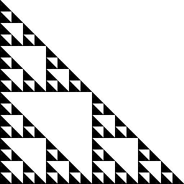
After 4 iterations
Notes:
Note that with the image is approaching a limit. Can see some convergence going on.

Slide 20

After 5 iterations
Notes:
Note that with the image is approaching a limit. Can see some convergence going on.

Slide 21

After 6 iterations
Notes:
Note that with the image is approaching a limit. Can see some convergence going on.

Slide 22

After 7 iterations
Notes:
Note that with the image is approaching a limit. Can see some convergence going on.

Slide 23
Introduction
Mathematical Background
2D Fractal Image Compression
3D Fractal Image Compression

Slide 24
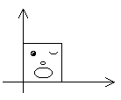
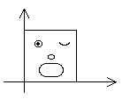
Geometry of Plane Transformations
Transformation/Mapping: A function that maps a space on to itself.
Affine Transformation: Transformation composed of scaling, reflection, rotation, and translation.
Scaling:
Scaling
Notes:
Scaling enlarges or shrinks an object.
Uniform scaling.

Slide 25
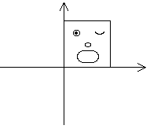
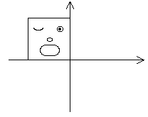
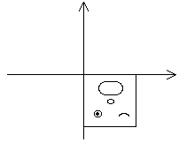
Reflection:
Reflection about the y-axis.
Reflection about the x-axis.
Notes:
Every point is reflected about a line of reflection.

Slide 26
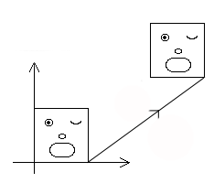
Translation:
Translation by some vector
Notes:
Every point is moved by some vector meaning each point is moved by some distance in some direction.

Slide 27
Some Math Background for IFS
Metric space: It is an ordered pair where is a non-empty set and is a metric (distance function). Example: Euclidean Plane
Notes:
Background to talk about limits of sets

Slide 28
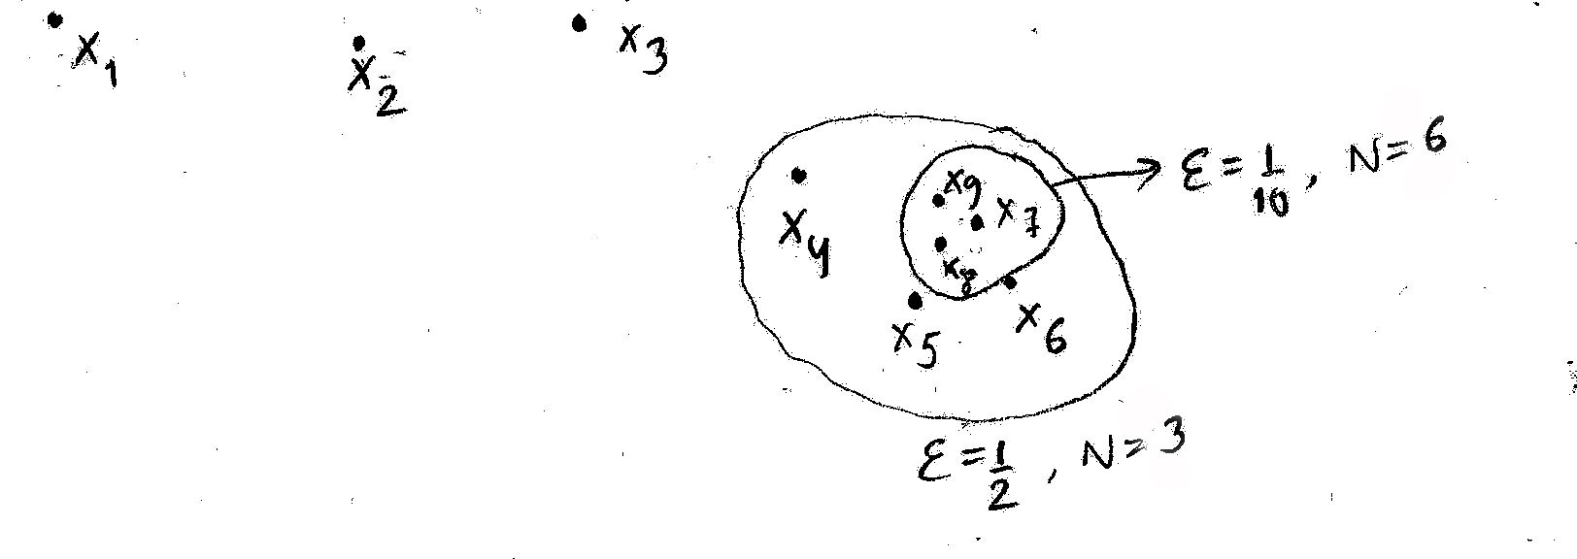
Cauchy sequence: A sequence of points in a metric space is called a Cauchy sequence if, for any given number , there is an integer such that for all .
Complete metric space: A metric space is complete if every Cauchy sequence in has a limit .
Notes:
If there is a sequence in a metric space X that seems like it will converge, it it must converge. Complete metric space guarantees that there are no holes

Slide 29
Contraction Mapping: A transformation on a metric space is called a contraction mapping if there is a constant such that:
Fixed point: Let be a transformation on a space. A point such that is called a fixed point of the transformation.
Notes:
A transformation is a contraction mapping if it guarantees that the distance between two points after transformation is strictly less than the distance before transformation.

Slide 30
The Contraction Mapping Theorem: Let be a contraction mapping on a complete metric shape . Then possesses exactly one fixed point , and moreover for any point , the sequence converges to ; that is, , for each
Notes:
The limit of the contraction mapping is the fixed point.

Slide 31
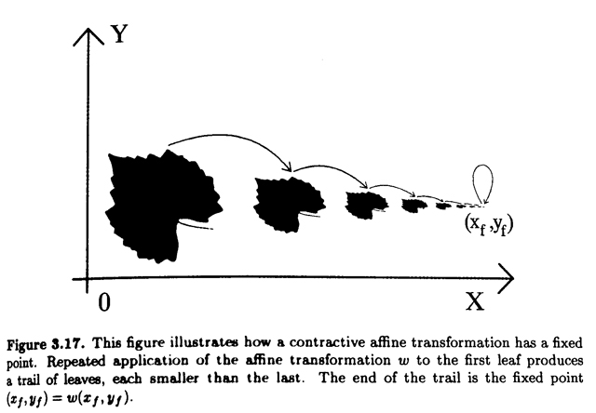

Slide 32
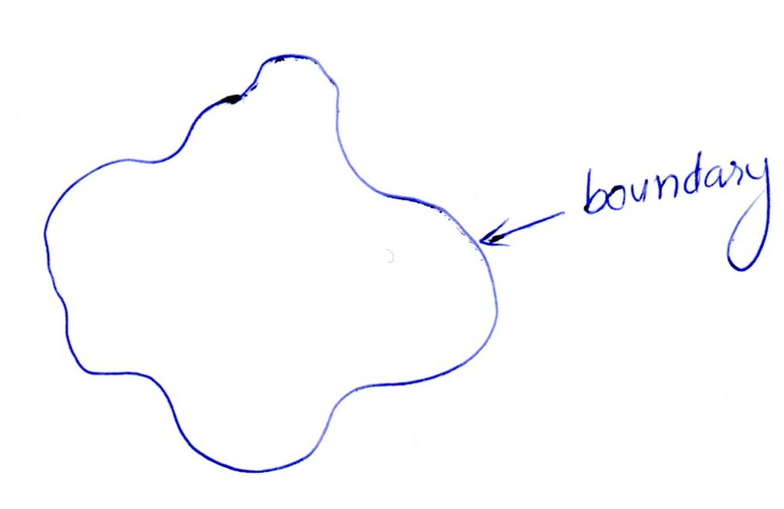
Compact Set: - is closed and bounded.
Hausdorff Space Let be a complete metric space. Then denotes the space whose points are the compact subsets of , other than the empty set. -each compact set of is a single point of .
A
Notes:
Limits of sets
Bounded because it is contained within a finite disc

Slide 33
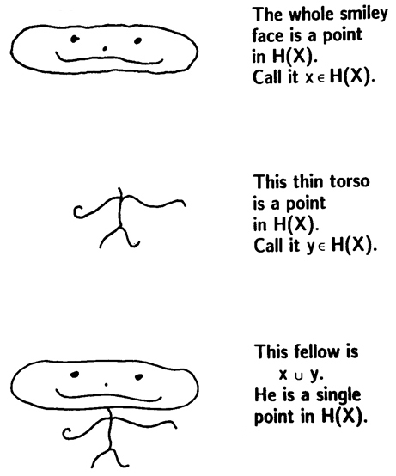

Slide 34
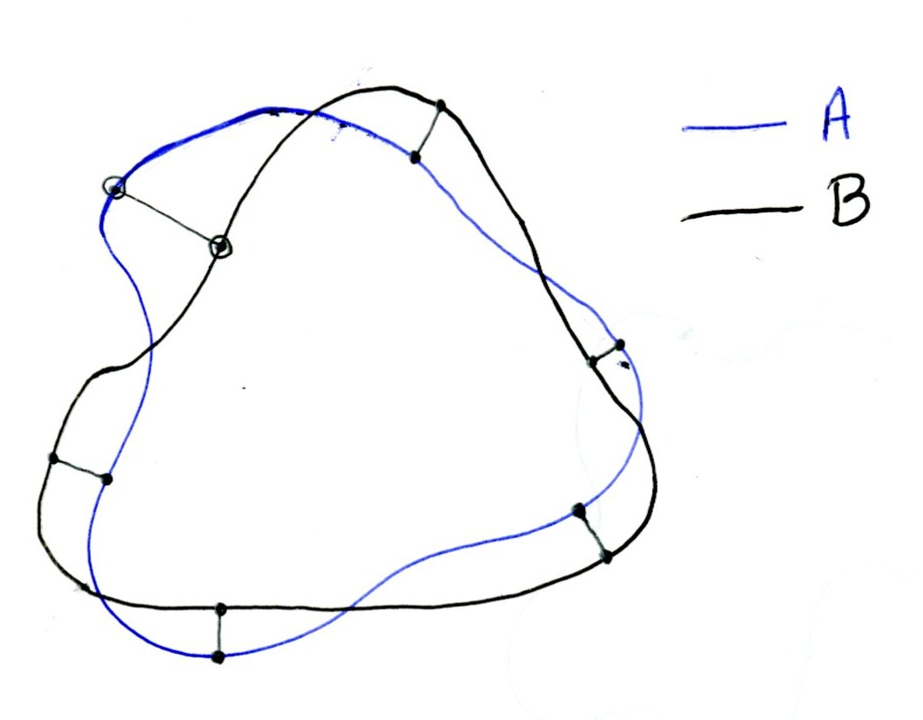
Distance between two points in H(X).
Notes:
Solid Sets.
Maximum of the minimum di

Slide 35
Distance between two points in H(X).
Minimum distance
Notes:
Solid Sets.
Maximum of the minimum di

Slide 36
Distance between two points in H(X).
Distance
here
is
zero
Notes:
Solid Sets.
Maximum of the minimum di

Slide 37
Distance between two points in H(X).
Minimum distance
Notes:
Solid Sets.
Maximum of the minimum di

Slide 38
Distance between two points in H(X). -Maximum of minimum distances
Notes:
Solid Sets.
Maximum of the minimum di

Slide 39
Contraction mapping on Let be a contraction mapping on the metric space with contractivity factor . Then defined by is a contraction mapping on with contractivity factor .
Notes:
Contraction mapping on a compact set is done by contraction mapping on each point in the compact set.
Set is mapped by mapping the points.

Slide 41
Iterated Function Systems (IFS)
An Iterated function system consists of a complete metric space together with a finite set of contraction mappings , with respective contractivity factors , for
IFS Theorem: Let be an iterated function system with contractivity factor . Then the transformation defined by for all , is a contraction mapping on the complete metric space with contractivity factor ; that is
Notes:
Union of contraction mappings on X is a contraction mapping on H(X)

Slide 42
It has a unique fixed set, , which obeys and is given by for any A is attractor of the contraction mappings.
Notes:
If we keep applying contraction mappings on the compact sets of H(X) then we wind up with some compact set that is the limit of the compact set.

Slide 43
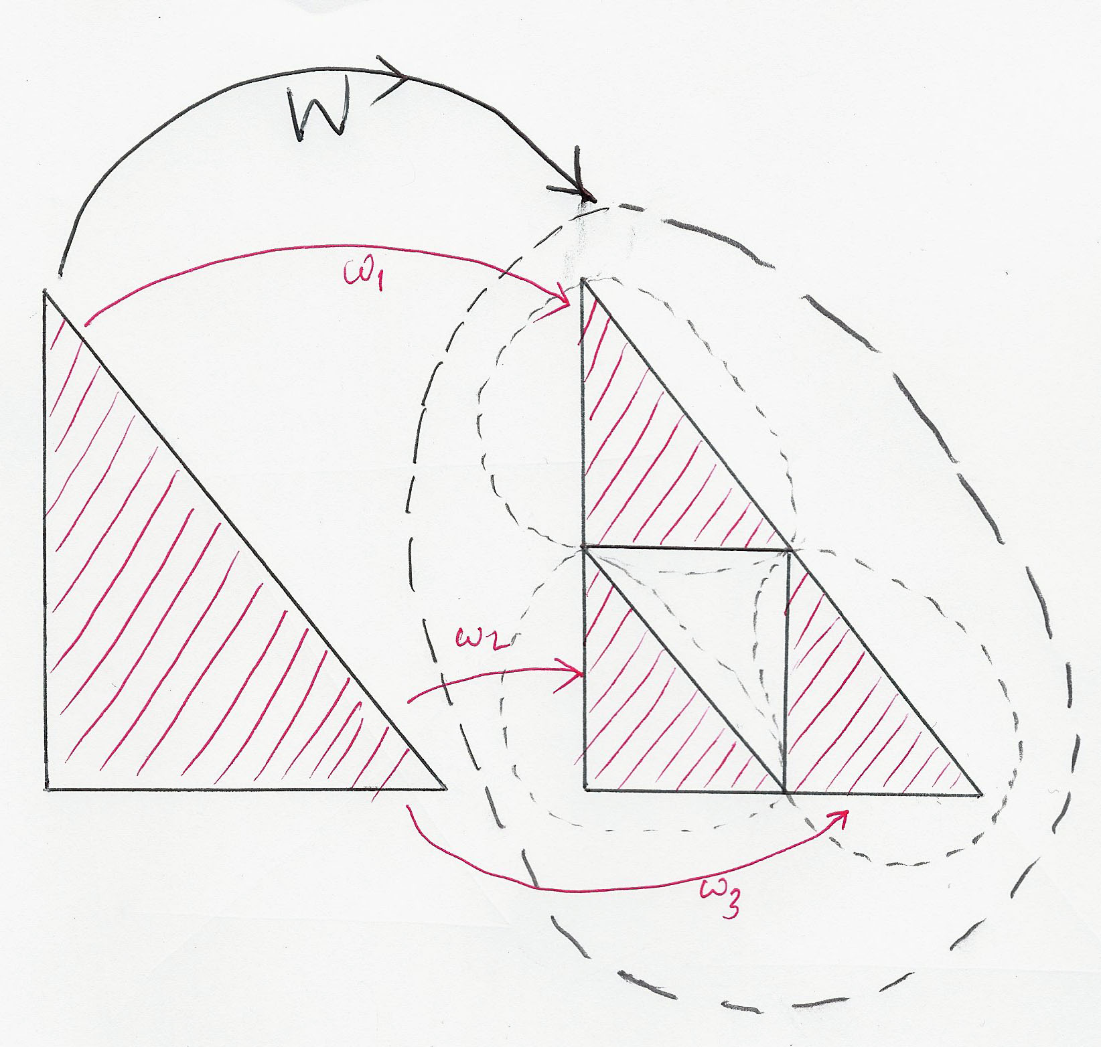
B
A
C
D

Slide 44
Notes:
Note that with the image is approaching a limit. Can see some convergence going on.

Slide 45
Notes:
Note that with the image is approaching a limit. Can see some convergence going on.

Slide 46
Notes:
Note that with the image is approaching a limit. Can see some convergence going on.

Slide 47
Notes:
Note that with the image is approaching a limit. Can see some convergence going on.

Slide 48
Notes:
Note that with the image is approaching a limit. Can see some convergence going on.

Slide 49
Notes:
Note that with the image is approaching a limit. Can see some convergence going on.

Slide 50
Notes:
Note that with the image is approaching a limit. Can see some convergence going on.

Slide 51
Notes:
Note that with the image is approaching a limit. Can see some convergence going on.

Slide 52
The Attractor is the limit of n iterations of the contraction mappings.
The Attractor
Notes:
Note that with the image is approaching a limit. Can see some convergence going on.

Slide 53
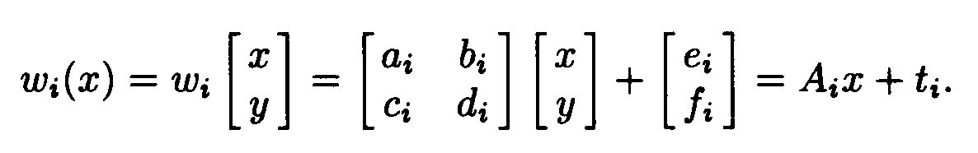
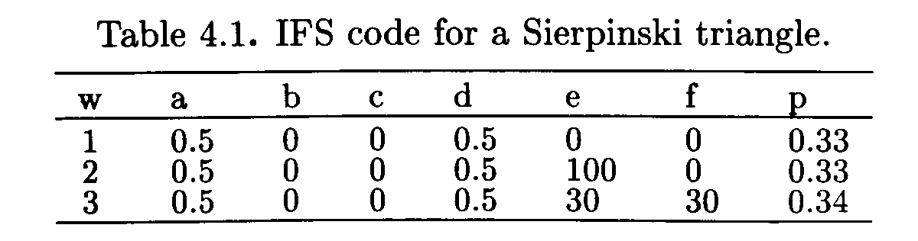
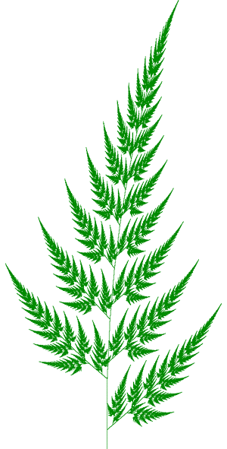
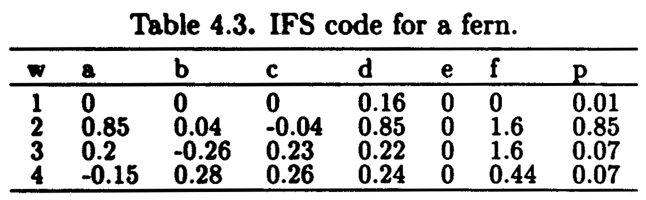

Slide 54
Linear transformation
Translation
- resolution independent.

Slide 55
How is compression achieved using IFS?
M. Barnsley suggested that storing images as collections of transformations could lead to image compression.
Image of fern (100*100 pixels) would require 65, 536 bits.
Transformation maps would require only 768 bits
Compression ratio of 85.3 to1
Compression ratio is the ratio of the memory required to store an image as a collection of pixels and the memory required to store a representation of the image in compressed form.

Slide 56
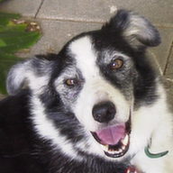

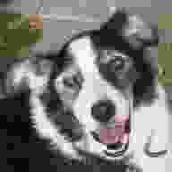
Lossy Compression
Fractal Image Compression is a Lossy compression as opposed to lossless.
Compression is achieved by disregarding some information in the original image.
Results in an image somewhat different from the original.
Close enough to fool the human eye.
Original (109kb)
84% less info (9.3 kb)
98% less info (1.2 kb)

Slide 57
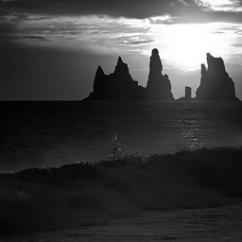
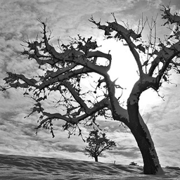
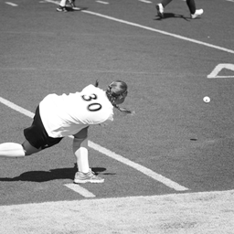
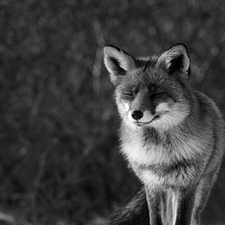
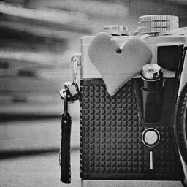

But… we’re actually interested in compressing natural images images like these:

Slide 58
The Collage Theorem: - this theorem is central to the design of IFS’s whose attractors are close to given sets. Let be a complete metric space. Let be given, and let be given. Choose and IFS with contractivity factor so that where is the Hausdorff metric. Then where is the attractor of the IFS.
Notes:
If you have a set of contraction mappings that define a collage that is close to the image in H(X). Then you can choose a finite set of contraction mappings for an IFS who’s attractor is approximately close to the original set.

Slide 59

Notes:
Union 14 contraction mappings defines a collage.

Slide 60
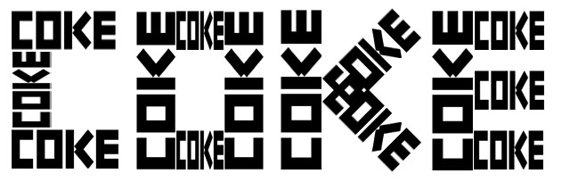
Notes:
Union 14 contraction mappings defines a collage.

Slide 61
Notes:
Union 14 contraction mappings defines a collage.

Slide 62
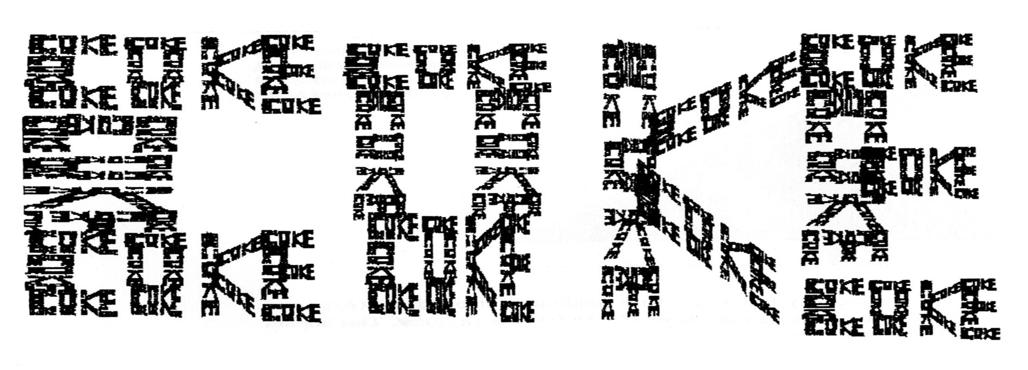
Notes:
Union 14 contraction mappings defines a collage.

Slide 63
If we have a set of contraction mappings that defines a collage, the collage theorem guarantees that we can generate an attractor that is almost as close to the original set as the collage.
Find a set of contraction mappings such that the collage of the given set under the transformations is near to the given set.

Slide 64
The Inverse Problem (Compression)
Think of a digital image (n x n) as a set of pixels.
In digital imaging, a pixel is the smallest element of a picture with only one specific color intensity.
Grey scale image is a set of pixels with intensity values between 0(black) and 255(white).
Notes:
Think of images as compact set of pixels

Slide 65
HOW TO FIND CONTRACTION MAPPINGS?
The image does not appear to contain affine transformations of itself.
Natural Images are not exactly self-similar.
Different sort of self-similarity.

Slide 66
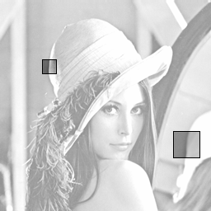
HOW TO FIND CONTRACTION MAPPINGS?
Some parts are made of smaller copies of other parts.
Note on the right, the small square is similar to the larger square.
We can find a contraction mapping that map the larger image to the smaller one.
Image we encode using this scheme will not be an identical copy but an approximation

Slide 67
Introduction
Mathematical Background
2D Fractal Image Compression
3D Fractal Image Compression

Slide 68
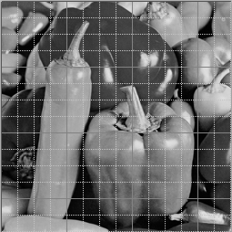
2D Fractal Image Compression Algorithm
The Idea here is to partition the image into a grid such that the dimension of each partition is (x * x).
x is the parameter to control the quality of the attractor.
Smaller dimension of the domain block results in a better approximation of the domain.
(y * y) image

Slide 69
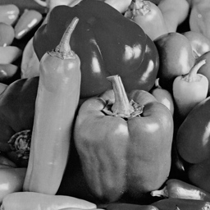

2D Fractal Image Compression Algorithm
RANGE
DOMAIN
Reduced (128 * 128)
Range is half the size of the domain.
Original Image (256 * 256)

Slide 70
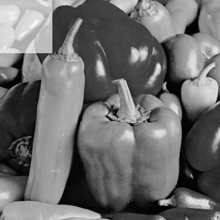

2D Fractal Image Compression Algorithm
Domain block (x * x) (each non overlapping partition)
Range block (x * x)
RANGE
DOMAIN
Reduced (128 * 128)
Range block has the same dimension as the domain block.
Original Image (256 * 256)

Slide 71
Iterate through each non-overlapping domain block.

Slide 72
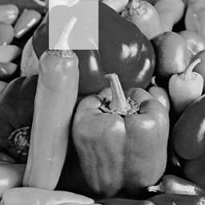
Iterate through each non-overlapping domain block.

Slide 73

Iterate through each non-overlapping domain block. - Calculate the average greyscale intensity of all the pixels in the domain block.

Slide 74
Then for each domain block iterate through all possible overlapping range blocks in the range.

Slide 75

Then for each domain block iterate through all possible overlapping range blocks in the range.

Slide 76

Then for each domain block iterate through all possible overlapping range blocks in the range.

Slide 77

Then for each domain block iterate through all possible overlapping range blocks in the range.

Slide 78

Then for each domain block iterate through all possible overlapping range blocks in the range.

Slide 79
Then for each domain block iterate through all possible overlapping range blocks in the range.
For each range block, calculate the average greyscale intensity.
For each range block consider all possible symmetries.

Slide 80
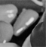

Domain block (x * x)
Range block (x * x)

Slide 81


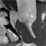
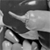
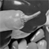
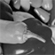
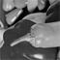
For each possible symmetry of the range block, calculate the Hausdorff distance between the domain and the range block.
Hausdorff distance in this case is the sum of the squares of the differences between the color intensities of corresponding pixels of the domain and range block.
Domain block (x * x)
8 possible symmetries of range block.
Symmetries obtained using a combination of reflection and rotation.

Slide 82
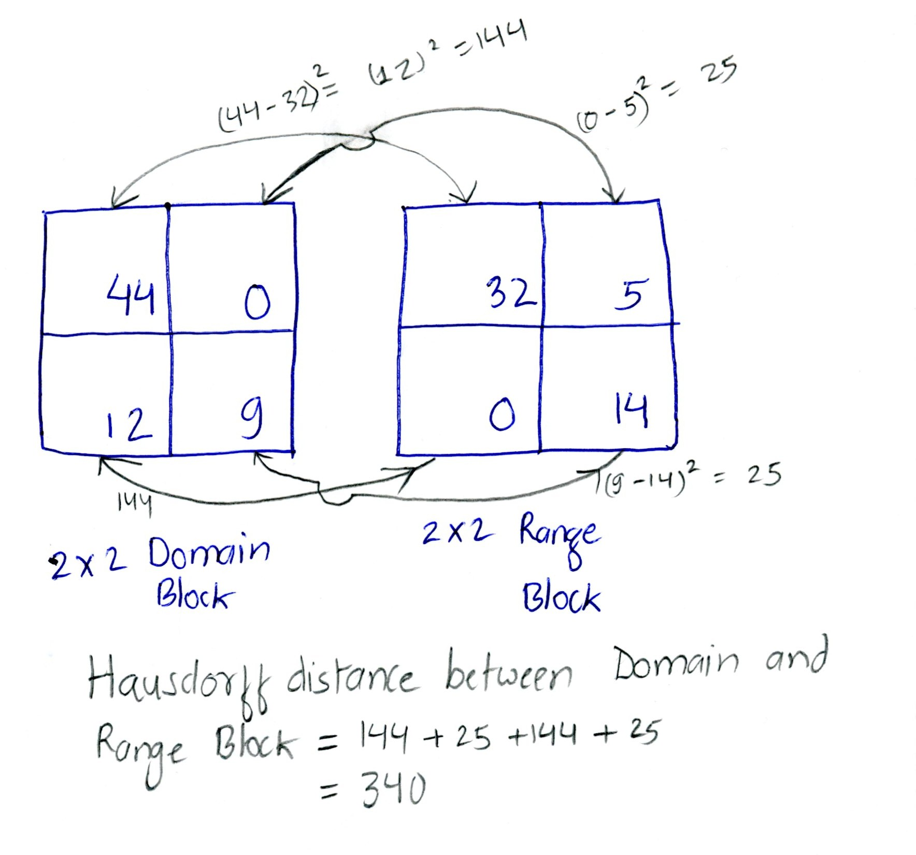
Hausdorff distance between two images.

Slide 83
Pick the symmetry that has the least Hausdorff distance from the domain block.
Record the x, y location, symmetry used, and the intensity shift of the range block which constitutes the affine map required to generate the domain block from the range block.
The intensity shift between the domain and range block is the difference between their average color intensities.
Write the affine transformation to a text file.
Now pick the next domain block and continue the process.

Slide 84
We get a Fractal Code File with a number of affine transformation maps…. 256 4 8 12 4 44 21 12 0 23 15 1 2 30 34 23 4 23 19 56 2 51 49 37 4 40 29 54 0 104 50 25 2 25 49 0 0 40 18 5 3 9 29 5 5 4 50 56 6 17 1 31 3 36 26 2 0 15 25 3 2 20 35 39 1 -23 39 2 0 27 44 36 0 65 ….
Header: 256 = length of the image 4 = length of the domain/range block.
Affine map: a b c d a = x coordinate of range block b = y coordinate of range block
c = symmetry used
d = intensity shift

Slide 85
Decompression Algorithm
Decompression algorithm is an IFS using the contraction maps generated during compression. - Iterate through the domain blocks in the same order followed when the image was compressed. - read the header information. - create a domain image with the dimension read from the- header and and set all color intensities of the pixels to 0(black). - create a range image half the size of the domain image and set all color intensities of the pixels to 0(black).

Slide 86



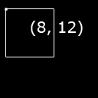
Decompression algorithm is just an IFS using the affine maps generated during compression.
Starting Range
Domain after applying first map
Starting Domain
Affine Map:
8 12 4 44
Sample From Range

Slide 87
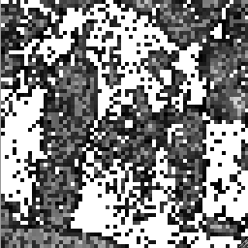
Decompression Step by Step:
Original Image
Image after 1 iteration
Size of the domain block

Slide 88
Decompression Step by Step:
Original Image
Image after 1 iteration

Slide 89
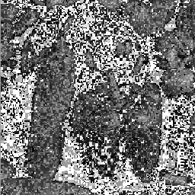
Decompression Step by Step:
Original Image
Image after 2 iterations

Slide 90
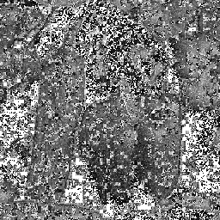
Decompression Step by Step:
Original Image
Image after 3 iterations

Slide 91

Decompression Step by Step:
Original Image
Image after 4 iterations

Slide 92

Decompression Step by Step:
Original Image
Image after 6 iterations

Slide 93

Decompression Step by Step:
Original Image
Image after 8 iterations

Slide 94

Decompression Step by Step:
Original Image
Image after 10 iterations

Slide 95

Decompression Step by Step:
Original Image
Image after 12 iterations

Slide 96

Decompression Step by Step:
Original Image
Image after 15 iterations

Slide 97

Decompression Step by Step:
Original Image
Image after 16 iterations

Slide 98
Decompression Step by Step:
Original Image PNG file size: 176 KB
Final Image after Decompression Compressed TXT file size: 20 KB
Compression ratio: 8.8 to 1

Slide 99
Results: Algorithm Time complexity of O(n⁴)
File Name | PNG File Size (KB) | FCF File Size (KB) | Compression Factor |  | Time (s)
1 | 131 | 16 | 8.2 | to 1 | 99
2 | 160 | 16 | 10.0 | to 1 | 101
3 | 143 | 16 | 8.9 | to 1 | 109
4 | 61 | 4 | 15.3 | to 1 | 136
5 | 70 | 4 | 17.5 | to 1 | 128
6 | 180 | 16 | 11.3 | to 1 | 116
7 | 49 | 4 | 12.3 | to 1 | 105
8 | 160 | 16 | 10.0 | to 1 | 110
9 | 152 | 16 | 9.5 | to 1 | 101
10 | 172 | 16 | 10.8 | to 1 | 111
11 | 168 | 16 | 10.5 | to 1 | 126
12 | 176 | 16 | 11.0 | to 1 | 135
13 | 86 | 8 | 10.8 | to 1 | 126
14 | 53 | 4 | 13.3 | to 1 | 121
15 | 152 | 16 | 9.5 | to 1 | 128
16 | 152 | 16 | 9.5 | to 1 | 132
17 | 180 | 16 | 11.3 | to 1 | 105
18 | 152 | 16 | 9.5 | to 1 | 122
19 | 147 | 16 | 9.2 | to 1 | 134
20 | 139 | 16 | 8.7 | to 1 | 114
21 | 213 | 16 | 13.3 | to 1 | 99
22 | 164 | 16 | 10.3 | to 1 | 107
23 | 147 | 16 | 9.2 | to 1 | 107
24 | 205 | 16 | 12.8 | to 1 | 123
25 | 188 | 16 | 11.8 | to 1 | 130
26 | 188 | 16 | 11.8 | to 1 | 125
27 | 209 | 16 | 13.1 | to 1 | 115
28 | 176 | 16 | 11.0 | to 1 | 108
29 | 176 | 16 | 11.0 | to 1 | 136
30 | 160 | 12 | 13.3 | to 1 | 118
 |  | AVERAGE | 11.1 | to 1 | 117.6
 |  | STD DEV | 2.1 |  | 12.0

Slide 100
Introduction
Mathematical Background
2D Fractal Image Compression
3D Fractal Image Compression

Slide 101

3D Fractal Image Compression
Voxel : - Analogous to a pixel in 2D images. - Volume element, representing a value on a regular grid in three dimensional space.
Compression / Decompression algorithm is very similar to 2D version.
An extra 3rd dimension is considered.
A single voxel
4 x 4 3D Volume

Slide 102
There is a PROBLEM!
Seems simple enough to add one dimension.
Direct extension to compress 3D images was very very very slow.
Adding the 3rd dimension increased the time complexity from O(n⁴) to O(n⁶).
Projected time to compress a 176 x 176 x 176 CT volume of a human brain was around 4 days (running a single core).

Slide 103

Solution… well good enough for now…
Partition the 3D image 64 smaller cubes.
Consider each of the smaller cube a domain.
Decide on the order to pick the next cube.
Run O(n⁶) 3D Compression algorithm on each of the smaller cubes.
Time to compress reduced to ~ 80 minutes.
Decompression is just the opposite (following the same order in which the smaller cubes where chosen for compression.)

Slide 104



Result:
Original uncompressed raw 3D Image size: 6144 KB
Back
Top
Side
2D slices of the 3D image from three different perspectives BEFORE compression.

Slide 105



Result:
Original Uncompressed raw 3D Image size: 6144 KB Compressed FCF 3D image size: 332 KB Compression Ratio: 18.5 to 1
Before
Slice 88
After

Slide 106






Back View
Top View
Side View
Original
SLICE 1
Compressed

Slide 107






Back View
Top View
Side View
Original
SLICE 15
Compressed

Slide 108






Back View
Top View
Side View
Original
SLICE 30
Compressed

Slide 109






Back View
Top View
Side View
Original
SLICE 45
Compressed

Slide 110






Back View
Top View
Side View
Original
SLICE 60
Compressed

Slide 111






Back View
Top View
Side View
Original
SLICE 75
Compressed

Slide 112






Back View
Top View
Side View
Original
SLICE 90
Compressed

Slide 113






Back View
Top View
Side View
Original
SLICE 105
Compressed

Slide 114






Back View
Top View
Side View
Original
SLICE 120
Compressed

Slide 115






Back View
Top View
Side View
Original
SLICE 135
Compressed

Slide 116






Back View
Top View
Side View
Original
SLICE 150
Compressed

Slide 117






Back View
Top View
Side View
Original
SLICE 165
Compressed

Slide 118






Back View
Top View
Side View
Original
SLICE 176
Compressed

Slide 119
References
Fisher, Yuval. Fractal Image Compression: Theory and Application. New York: Springer-Verlag New York, INC, 1995. Print.
Barnsley, Michael, and Lyman Hurd. Fractal Image Compression. Wellesley: A K Peters Ltd., 1993. Print.
Barnsley, Michael. Fractals Everywhere. San Diego: Academic Press, INC, 1988. Print.
Mandelbrot, Benoit, Nail Neger, and Michael Frame. "Fractal Geometry." Yale Fractal Geometry. Yale University, n.d. Web. 9 Oct 2010. <http://classes.yale.edu/fractals/>.

